Slide 1



Permissions & Content Providers II

Slide 2
Multiple Permissions
AndroidManifest.xml
<?xml version="1.0" encoding="utf-8"?> <manifest xmlns:android="http://schemas.android.com/apk/res/android" package="com.example.contactreader"> <uses-permission android:name="android.permission.READ_CONTACTS" /> <uses-permission android:name="android.permission.WRITE_CONTACTS" />
override fun onCreate(savedInstanceState: Bundle?) { super.onCreate(savedInstanceState) setContentView(R.layout.activity_main) checkPermission( android.Manifest.permission.READ_CONTACTS, READ_CONTACT_PERMISSION_CODE) checkPermission( android.Manifest.permission.WRITE_CONTACTS, WRITE_CONTACT_PERMISSION_CODE)
….
}
MainActivity.kt

Slide 3
checkPermission Function
MainActivity.kt
class MainActivity : AppCompatActivity() { companion object { private const val READ_CONTACT_PERMISSION_CODE = 111 private const val WRITE_CONTACT_PERMISSION_CODE = 112 } var cName:String = "" var cNumber:String ="" var cType:String ="“
private fun checkPermission(permission: String, requestCode: Int) { if (ContextCompat.checkSelfPermission(this@MainActivity, permission) == PackageManager.PERMISSION_DENIED) { // Requesting the permission ActivityCompat.requestPermissions(this@MainActivity, arrayOf(permission), requestCode) } else { Toast.makeText(this@MainActivity, "Permission already granted", Toast.LENGTH_SHORT).show() readcontacts() } } ..
Add some constants
Add global variables

Slide 4
onRequestPermisssionResult
MainActivity.kt
override fun onRequestPermissionsResult(requestCode: Int, permissions: Array<String>, grantResults: IntArray) { super.onRequestPermissionsResult(requestCode, permissions, grantResults) var Permissions_counter: Int = 0 if (requestCode == READ_CONTACT_PERMISSION_CODE) { if (grantResults.isNotEmpty() && grantResults[0] == PackageManager.PERMISSION_GRANTED) { Toast.makeText(this@MainActivity, "Read Contacts Permission Granted", Toast.LENGTH_SHORT).show() Permissions_counter += 1 } else { Toast.makeText(this@MainActivity, "Read ContactsPermission Denied", Toast.LENGTH_SHORT).show() } } if (requestCode == WRITE_CONTACT_PERMISSION_CODE) { if (grantResults.isNotEmpty() && grantResults[0] == PackageManager.PERMISSION_GRANTED) { Toast.makeText(this@MainActivity, "Write Contacts Permission Granted", Toast.LENGTH_SHORT).show() Permissions_counter += 1 } else { Toast.makeText(this@MainActivity, "Write Contacts Permission Denied", Toast.LENGTH_SHORT).show() } } Toast.makeText(this@MainActivity, "Counter"+Permissions_counter, Toast.LENGTH_SHORT).show() if (Permissions_counter==2) readcontacts() }

Slide 5



Create bar item menu
Right Click(drawable)-> new -> Vector Asset ->ic_baseline_add_24
contracts_menu.xml
<?xml version="1.0" encoding="utf-8"?> <menu
xmlns:android="http://schemas.android.com/apk/res/android" xmlns:app="http://schemas.android.com/apk/res-auto"> <item android:id="@+id/item1" android:title="item 1" android:icon="@drawable/ic_baseline_add_24" app:showAsAction="ifRoom"/> </menu>
Right Click(res) -> new -> Android Resources Directory -> name it menu
In Menu create contacts_menu.xml

Slide 6
Calling bar action menu
MainActivity.kt
import android.view.Menu
import android.view.MenuItem
class MainActivity : AppCompatActivity() { …
override fun onCreateOptionsMenu(menu: Menu): Boolean {
// Inflate the menu to use in the action bar
val inflater = menuInflater
inflater.inflate(R.menu.contacts_menu, menu)
return true;
}
override fun onOptionsItemSelected(item: MenuItem): Boolean {
var dialog_var = AddCntactFragment()
dialog_var.show(supportFragmentManager, "Add Contact Dialog")
return true;
}
}
Some where after onCreate(){}
Calling the DialogFragment which will be implemented next slide

Slide 7
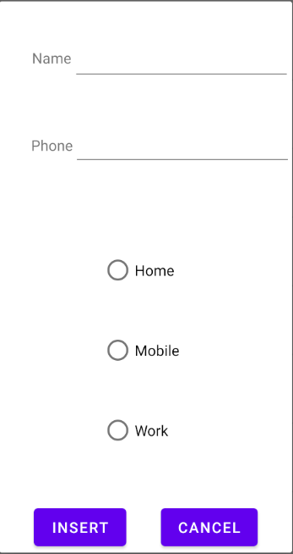
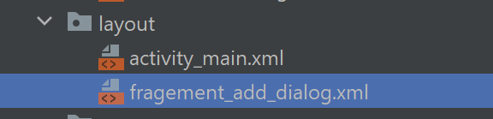
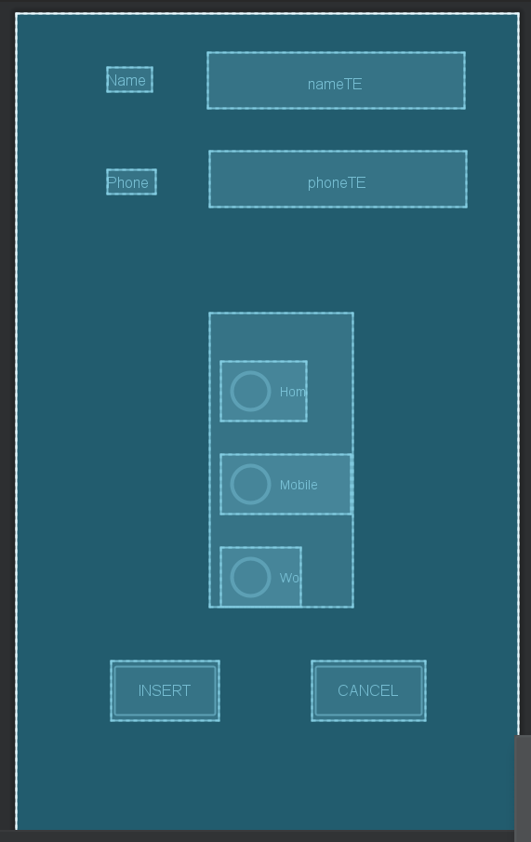
Creating DialogFragment
In layout create new xml file with name fragment_add_dialog.xml
For the full code, please refer to fragement_add_dialog.xml in the resources menu.

Slide 8
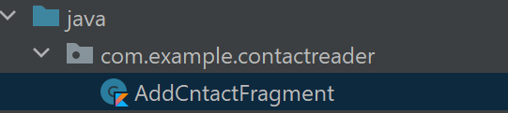
Creating DialogFragment
In java -> com.example.contactreader -> create new kotlin class, name it as AddCntctFragment.kt

Slide 9
AddCnctFragment.kt
class AddCntactFragment: DialogFragment(R.layout.fragement_add_dialog) { override fun onViewCreated(view: View, savedInstanceState: Bundle?) { val btn: Button = view.findViewById(R.id.insertBT) btn.setOnClickListener { val m1:MainActivity = getActivity() as MainActivity; val radioGroup:RadioGroup = view.findViewById(R.id.radioGroup) val selectedOption: Int = radioGroup.checkedRadioButtonId val nameET : EditText = view.findViewById(R.id.nameTE) val numberET : EditText = view.findViewById(R.id.phoneTE) val radioButton = view.findViewById<RadioButton>(selectedOption) m1.feedback(nameET.text.toString(),numberET.text.toString(),radioButton.text.toString()) dismiss() } val canclBT: Button = view.findViewById(R.id.cancelBT) canclBT.setOnClickListener { dismiss() } } }

Slide 10
MainActivity.kt (Feedback)
public fun feedback(_Name:String, _Number:String, _Type: String){ cName = _Name cNumber=_Number cType =_Type insertContactPhoneNumber( _Number , _Name,_Type ) }
Calling the insertContractPhoneNumber() which will be implemented next slide

Slide 11
MainActivity.kt (insertContractPhoneNumber)
private fun insertContactPhoneNumber(phoneNumber: String, displayName: String, phoneTypeStr: String) { val operations : ArrayList<ContentProviderOperation> = ArrayList<ContentProviderOperation>(); operations.add( ContentProviderOperation.newInsert(ContactsContract.RawContacts.CONTENT_URI) .withValue(ContactsContract.RawContacts.ACCOUNT_TYPE, null) .withValue(ContactsContract.RawContacts.ACCOUNT_NAME, null).build() ) if (displayName.trim { it <= ' ' } != "" && phoneNumber.trim { it <= ' ' } != "") { operations.add( ContentProviderOperation.newInsert(ContactsContract.Data.CONTENT_URI) .withValueBackReference(ContactsContract.Data.RAW_CONTACT_ID, 0) .withValue( ContactsContract.Data.MIMETYPE, ContactsContract.CommonDataKinds.StructuredName.CONTENT_ITEM_TYPE ) .withValue( ContactsContract.CommonDataKinds.StructuredName.DISPLAY_NAME, displayName ).build() )
Continue ..

Slide 12
MainActivity.kt (insertContractPhoneNumber)
operations.add( ContentProviderOperation.newInsert(ContactsContract.Data.CONTENT_URI) .withValueBackReference(ContactsContract.Data.RAW_CONTACT_ID, 0) .withValue( ContactsContract.Data.MIMETYPE, ContactsContract.CommonDataKinds.Phone.CONTENT_ITEM_TYPE ) .withValue(ContactsContract.CommonDataKinds.Phone.NUMBER, phoneNumber) .withValue( ContactsContract.CommonDataKinds.Phone.TYPE, phoneTypeStr ).build() ) } try { contentResolver.applyBatch(ContactsContract.AUTHORITY, operations) Toast.makeText(applicationContext, "Insert Success", Toast.LENGTH_SHORT).show() } catch (e: Exception) { e.printStackTrace() Toast.makeText(applicationContext, "Insertion failed", Toast.LENGTH_SHORT).show() } }
MainActivity.kt is uploaded to the resources menu

Slide 13
References
https://developer.android.com/guide/topics/providers/content-provider-basics
https://www.youtube.com/watch?v=Sxf04knGhJE
https://www.youtube.com/watch?v=-oZlj1tugLQ&t=297s

